Slide 1
K8S Scheduling Framework
Yaohui Ding
Jan 3, 2022

Slide 2
Summary
Introduction of K8S Scheduling Framework
Code: kubernetes/pkg/scheduler/framework
Docs: community/contributors/devel/sig-scheduling/scheduler_framework_plugins.md
Take Co-scheduling plugin as an example: kubernetes-sigs/scheduler-plugins/pkg/coscheduling
Current Design of Fractional GPU Scheduling
Borrow ideas from AliyunContainerService/gpushare-scheduler-extender

Slide 3
Overview of Scheduling Framework
Scheduling framework is a pluggable architecture for the Kubernetes scheduler
new framework workflow: a simple core + plugins
Plugins:
Each scheduler plugin needs to register to being invoked at 1 or more extension points
Extension points:
Predefined by the framework. They are the only exposed interfaces we can customize in the framework
After v1.18, the framework is in use and “old features” are enabled as plugins by default
K8S SIGs Community also provides new features: kubernetes-sigs/scheduler-plugins/cmd/scheduler/main.go
These out-of-tree scheduler-plugin artifacts can be installed as single or second scheduler (will talk later).
We can configure a set of plugins as a profile, and define multiple profiles to fit various kinds of workload
Profiles
Each profile has an associated scheduler name, and has a set of plugins configured in extension points

Slide 4
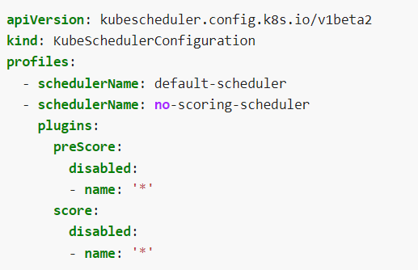
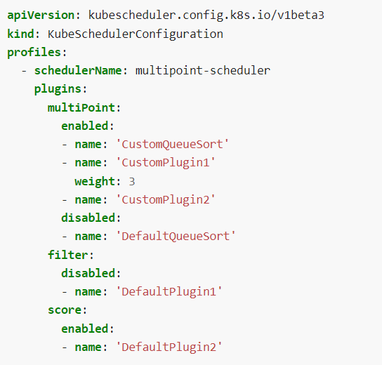
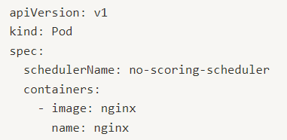
Example of Plugins, Extension Points and Profiles
1 - The following scheduler will run with two profiles/schedulerNames: 1) default plugins, 2) all scoring plugins disabled
3 - Once multiple plugins are enabled at the same extension points, use the “weight” field for priorities
Extension points
2 - Pods specific the preferred profile in its

Slide 5
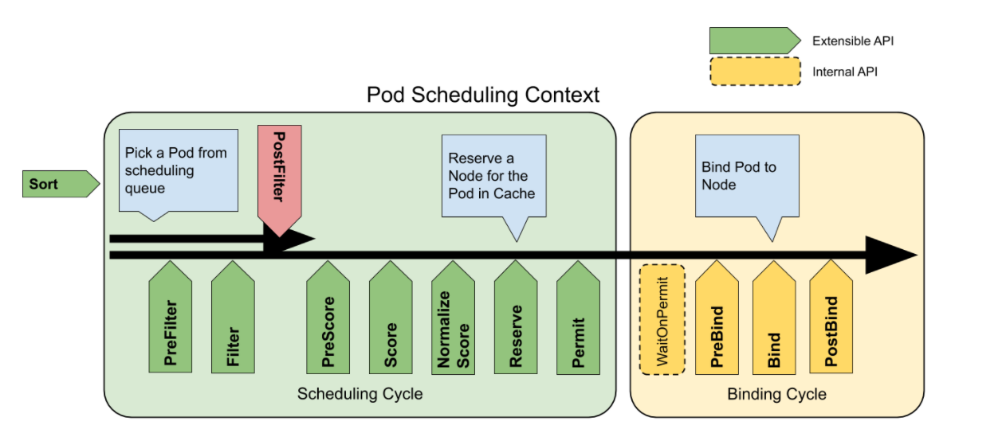
Extension Points
In framework, scheduling a Pod, aka “scheduling context”, has two phases: scheduling cycle and binding cycle
Scheduling cycle: select a node for the pod, serially
Binding cycle: apply the above decision to the cluster, concurrently
Both of them can be aborted if 1) the pod is “un-schedulable”, or 2) an error. Then the pod is returned to queue
Scheduling framework extension points

Slide 6
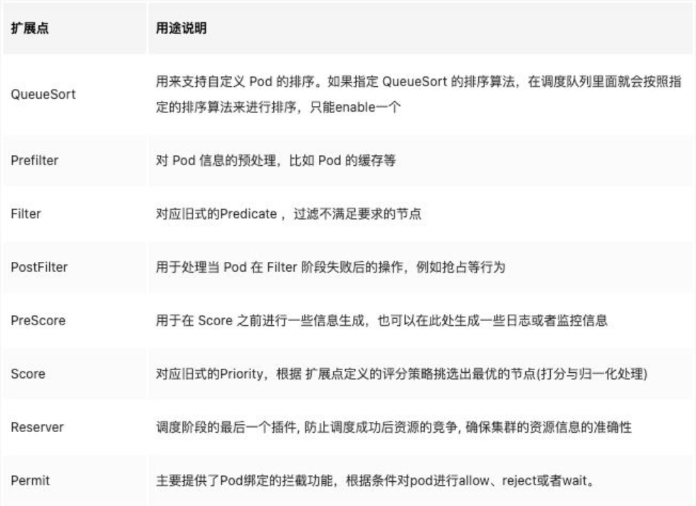
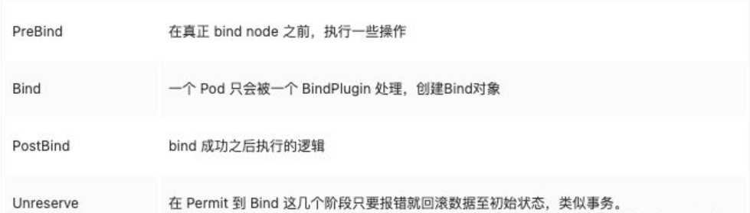
Extension Points
All extension points interface can be found in: /pkg/scheduler/framework/interface.go

Slide 7
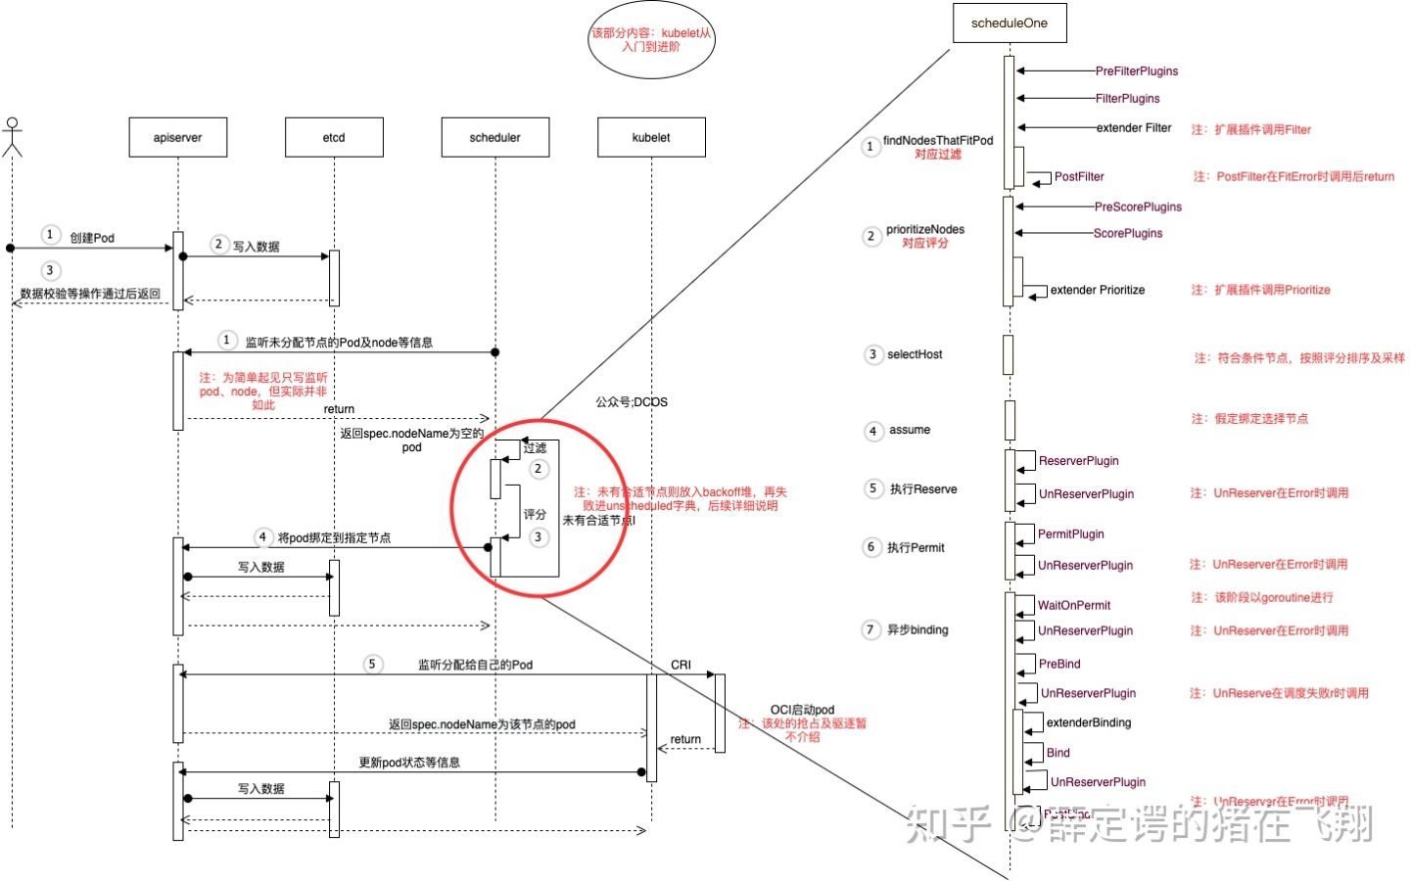

Slide 8
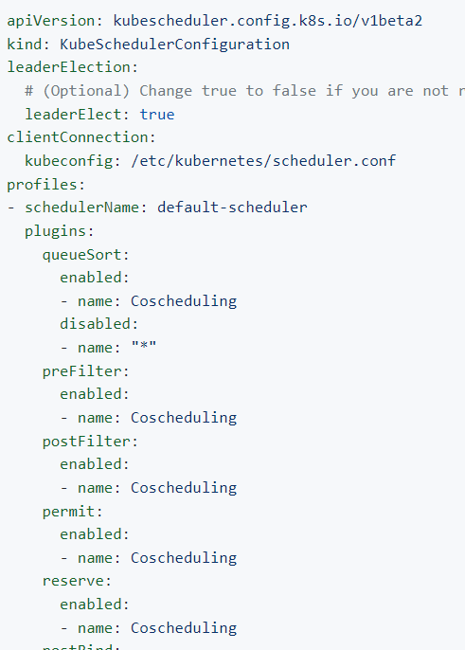
Build and Configure a Plugin
Backup your kube-scheduler.yaml
Create a KubeSchedulerConfiguration.yaml

Slide 9
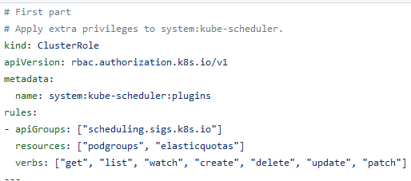
Build and Configure a Plugin
Several plugins (such as coscheduling) needs a CRD for its implementation, so
3.1 apply extra RBAC privileges to system:kube-scheduler
3.2 install the controller image
3.3 install the CRD required by coscheduling (podgroup CRD)

Slide 10
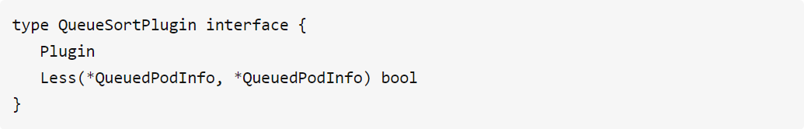
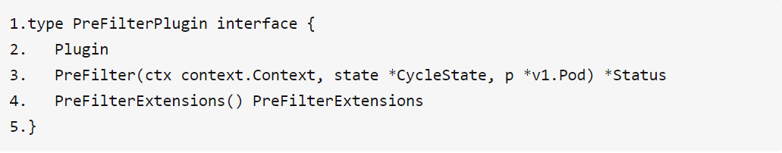
Plugin Develop Process
Write go code and implement your functions on extension points
Queue Sort:
PreFilter:

Slide 11
Current Design of Fractional GPU Scheduling
Goals
From users’ perspective, be able to run multiple inference tasks on the same GPU at the same time
From cluster manager’s perspective, be able to increase GPU usage of the cluster
Design Principles
Leverage Extended Resources to express GPU sharing request by changing the measure unit from “# of GPUs” to “amount of GPU memory in GiB”
Satisfy the “single device requirement”, which means the scheduler prefers keep a task running in single GPU/node rather than spread it among different GPUs/Nodes
Do not change any barebone code of K8S, just leverage device plugin and scheduling framework
Current Design: two-level filter and binpack
1st level: filter out the nodes that don’t have enough resource (in GiB)
2nd level: on feasible nodes, filter out the single GPU card that does not have enough resource (in GiB)
Binpack: assign higher score to the feasible GPU card which has higher usage

Slide 12
Current Design of Fractional GPU Scheduling
GPU job yaml
Requests vGPU-mem: 8
N1
N2
N3
Pod A
Pod B
Pod C
Pod D
Pod E
Pod F
16G
12G
12G
12G
8G
6G
16G
16G
16G
16G
16G
16G
GPU0
GPU1
GPU0
GPU1
GPU0
GPU1
Node level: 4G
Node level: 8G
GPU level:
- 4G on GPU0
- 4G on GPU1
Node level: 18G
GPU level:
- 8G on GPU0
- 10G on GPU1

